Slide 1
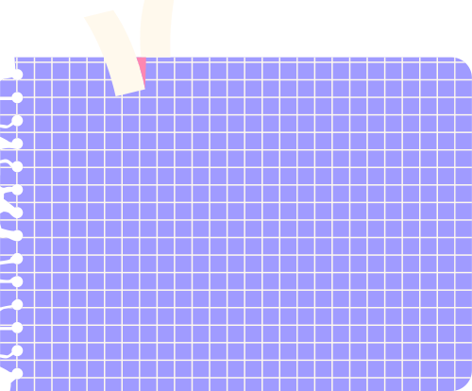





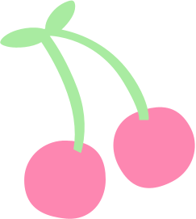




OTHER TURTLE FEATURES

Slide 2





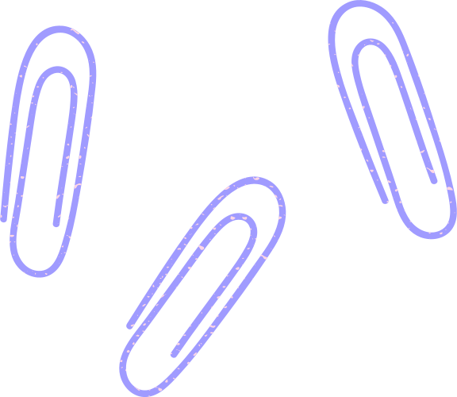
ENABLE Turtle
To work with Turtle, it is necessary to enable scripting mode for Turtle in Python IDLE. To do so, kindly follow the instructions as given in PPT T1-Turtle Graphics.

Slide 3

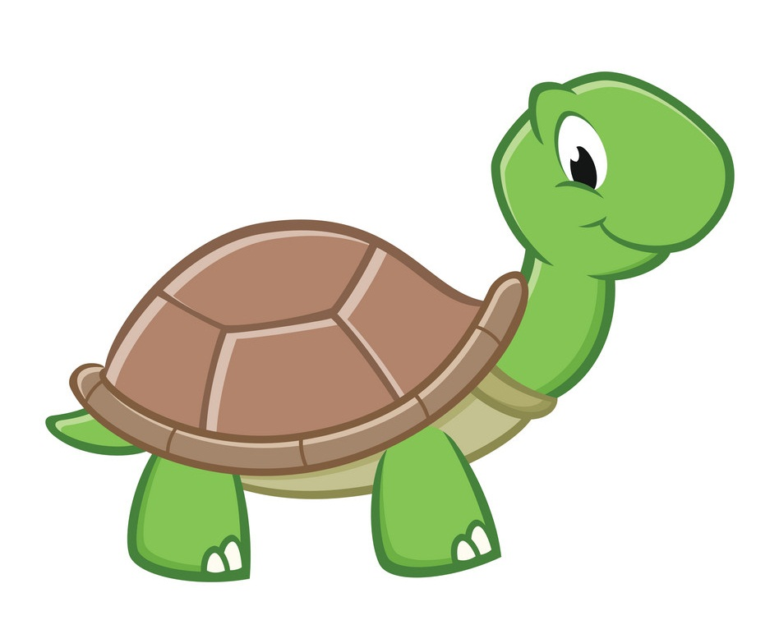
Turtle FEATURES
Turtle provides the following functions to draw, paint and create graphics designs:
Kindly refer to
PPT-T2 on Turtle Features before proceeding with
this one.

Slide 4
TELL THE IDLE
YOU WANT TO USE TURTLE
It is mandatory to inform IDLE that you are using Turtle to get all the functionalities given in Turtle. You can type the following command to do so:
from turtle import *

Slide 5
THE NECESSITY TO INFORM
It is mandatory to have the above said statement as the first statement of your Turtle Drawing in order to work with Turtle.

Slide 6

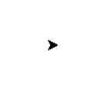
CREATE YOUR
OWN TURTLE
Turtle() function/command creates a new turtle which can be given a name:
my_turtle = Turtle()
This will open the Python Turtle Graphics window with your turtle at the centre.

Slide 7
Name your TURTLE
It is mandatory to name your Turtle according to Variable Naming Rules.
Kindly refer to PPT-6 on Keywords and Identifiers.

Slide 8
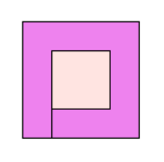
PICK UP AND DROP DOWN
In order to draw two concentric squares (one inside the other) on paper, we have to lift our pen from the paper and keep it at a point inside the bigger square to draw the smaller one.
To implement the same in Turtle, if we use the forward() function, we get this image.

Slide 9
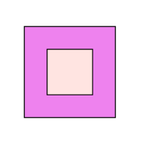
PICK UP AND DROP DOWN
To avoid having the extra line between the two squares, penup() and pendown() functions are used.
The code to cover the distance between the two squares, must be written between the two functions.
The code for drawing this image is attached below:

Slide 10
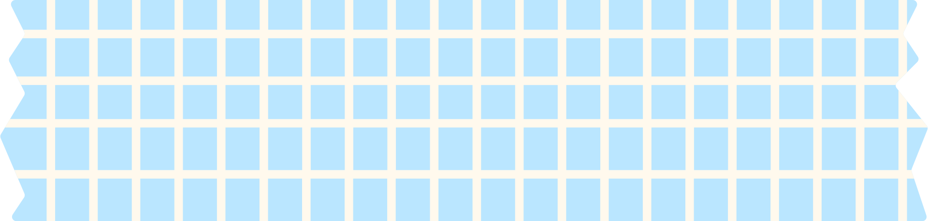











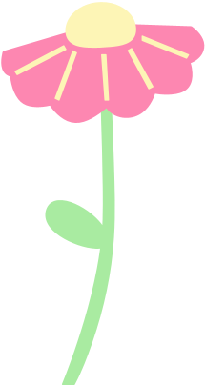


#Outer Square
t.color("black", "violet") #(outline, fill)
t.begin_fill()
#Code to Draw a Square
t.end_fill()
#Moving to the Inner Square
t.penup()
t.forward(25)
t.left(90)
t.forward(25)
t.pendown()
#Inner Square
t.color("black", "misty rose") #(outline, fill)
t.begin_fill()
#Code to Draw a Square
t.end_fill()
t.hideturtle()
CONCENTRIC SQUARES

Slide 11
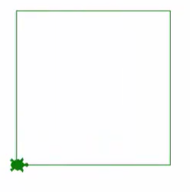


THROUGH THICK AND THIN
pensize() function increases or decreases the thickness of the pen.
my_turtle.pensize(1) #Default
my_turtle.pensize(10)
my_turtle.pensize(40)
DEFAULT
PENSIZE = 1
PENSIZE = 10
PENSIZE = 40

Slide 12
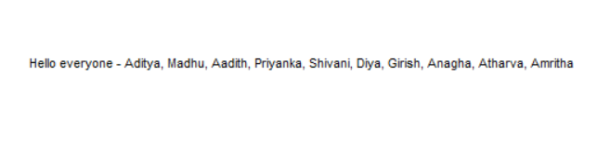
WRITE IT RIGHT
write() function allows us to add text in our Turtle Graphics Window.
my_turtle. write("Hello everyone - Aditya, Madhu, Aadith, Priyanka, Shivani, Diya, Girish, Anagha, Atharva, Amritha")
OUTPUT

Slide 13

START WITH A DOT
dot() function marks the current position of your turtle with a dot:
my_turtle. dot()
The default dot size is 5, that is, if you don’t specify anything inside the parentheses, the dot size is 5.

Slide 14

START WITH A DOT
You can choose to have a number inside the parentheses of dot() function:
my_turtle. dot(50)
This will increase the dot size to 50.

Slide 15

START WITH A DOT
You can also have dots of different colors. By specifying color as string argument for the dot() function:
my_turtle.dot(“red")
This will change the color of dot as red.

Slide 16

START WITH A DOT
We can specify both the arguments- size and color for a dot in the same function:
my_turtle.dot(50, “blue")
This will change the color of dot as blue and size as 50.

Slide 17


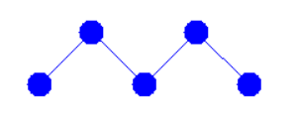

TRY THESE OUT!!

Slide 18

HAPPY LEARNING!

